Slide 1
Object oriented programming

Slide 2
What is Object oriented programming (oopS)
OOPS stands for Object-Oriented Programming in C#. It is a programming paradigm that uses objects to represent real-world entities, with each object containing data and behaviour .
In C#, OOPS is implemented using classes, which define the behaviour of objects, and objects, which are instances of classes.

Slide 3
Why? oops
Object-Oriented Programming (OOP) is used because it offers several benefits over other programming paradigms. Some of the major advantages of using OOP are:
Modularity
Reusability
Security
Flexibility
Scalability

Slide 4
Concepts of oop
Class
Object
Method
Inheritance
Abstraction
Encapsulation
Polimorphism

Slide 5
class
•A class is the blueprint from which the individual objects are created.
•A class defines the characteristics of an object
•It includes Attributes (its fields or properties) and the things it can do ( methods, operations or features).

Slide 6
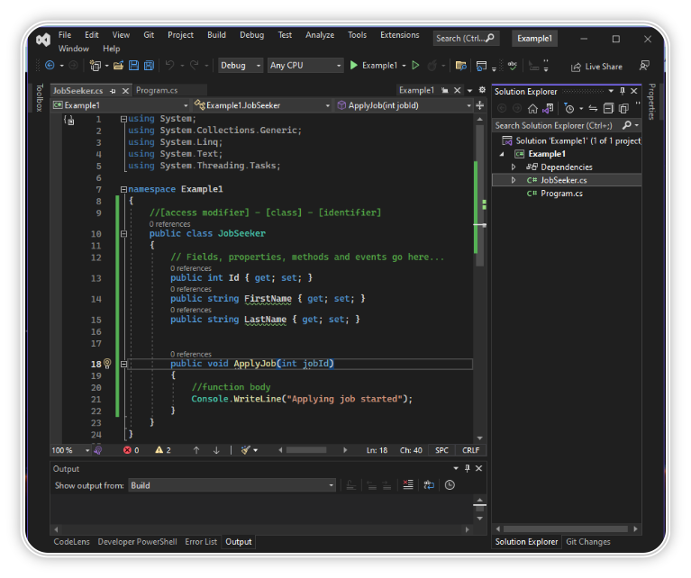
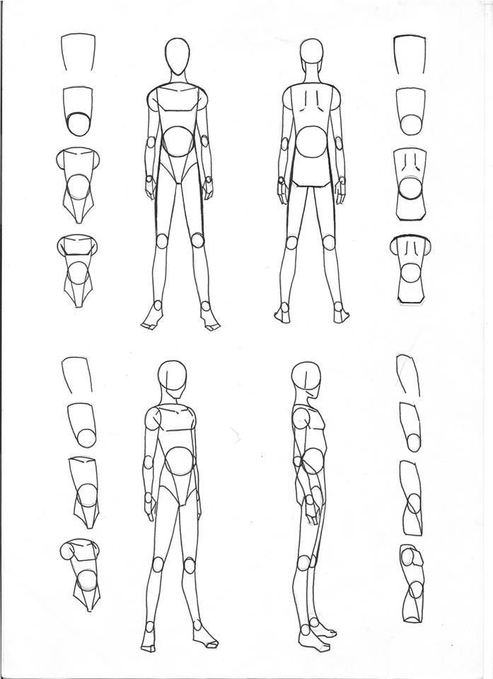
Examplle for class

Slide 7

Object
Objects are entities that have behavior , that hold information, and that can interact with one another.
In pure OOP terms an object is an instance of a class.

Slide 8
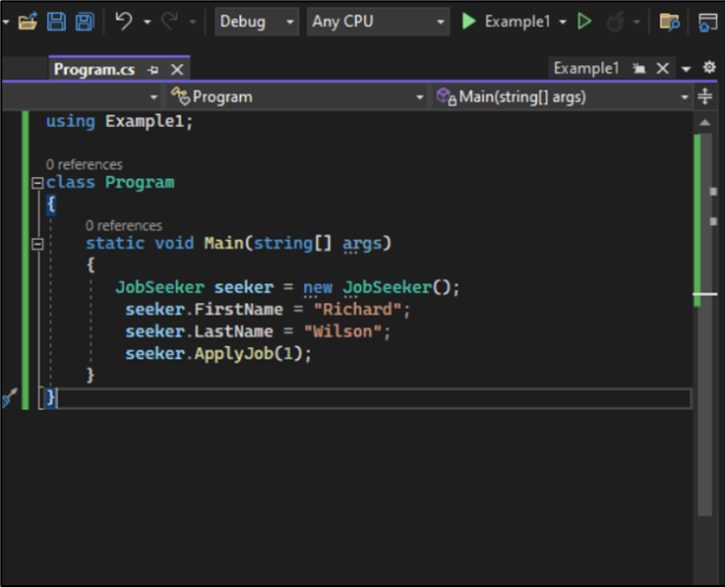
In C#, objects are created using the "new" keyword followed by the name of the class to be instantiated
Syntax:- Class name object name =new constructor();

Slide 9
inheritance
•Inheritance can be defined as the process where one class acquires the properties of another.
•A subclass(child) is a specialized version of a class, which inherits attributes and behaviors from the parent class
•A child may also have additional unique behaviors and properties of its own that its parent does not have.

Slide 10
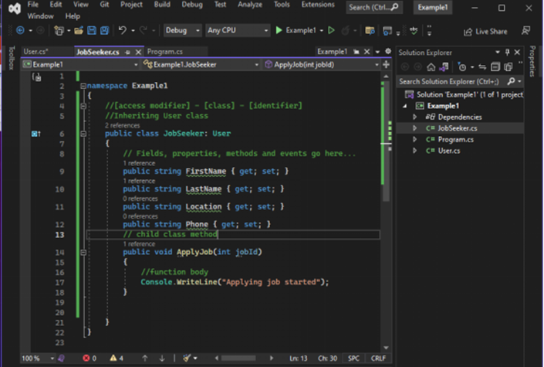
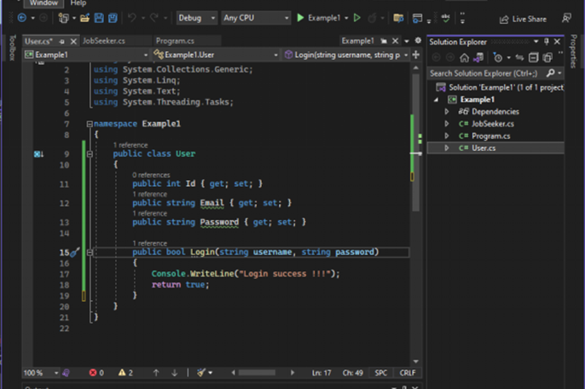

Slide 11
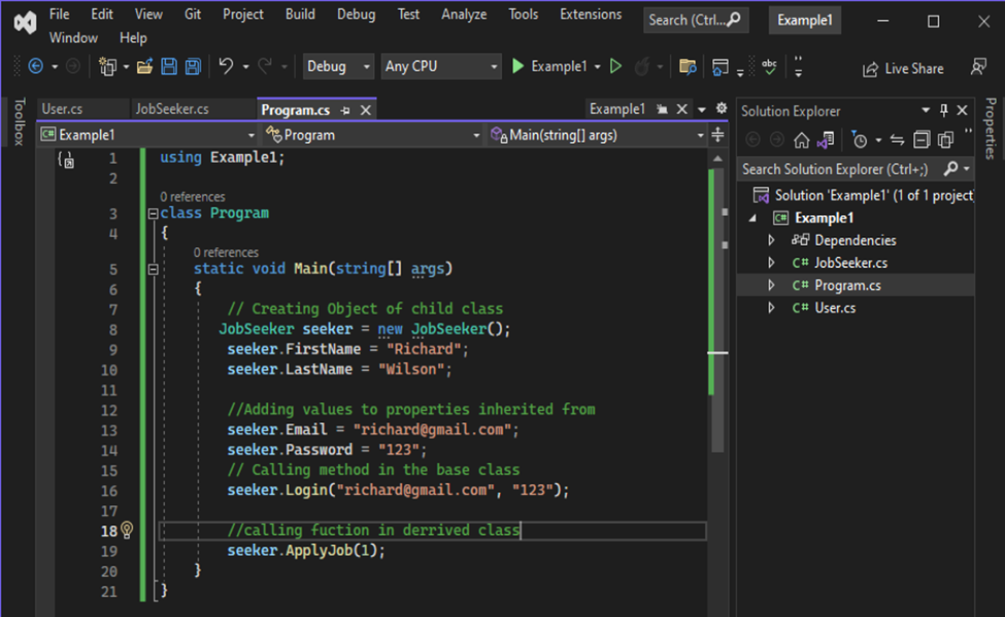

Slide 12
abstraction
•Abstraction is the practice of reducing details so that someone can focus on a few concepts at a time
•Abstraction is "To represent the essential feature without representing the background details.“
•Abstraction is the process of hiding the working style of an object, and showing the information of an object in an understandable manner.

Slide 13
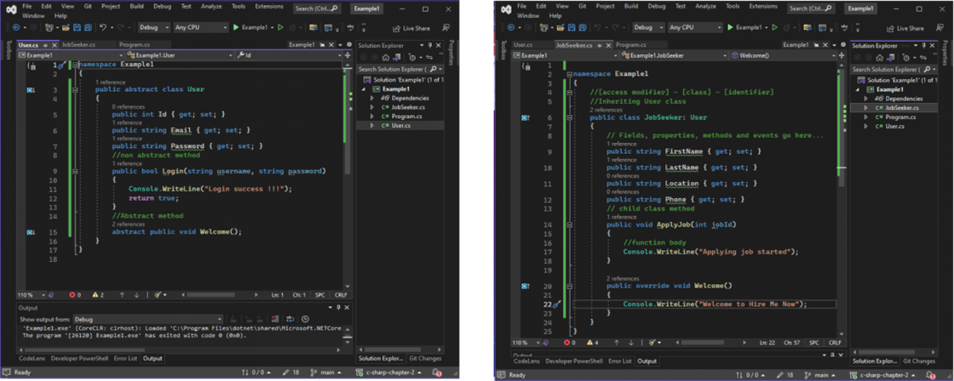

Slide 14
encapsulation
•Encapsulation Hiding the internal state and functionality of an object and only allowing access through a public set of functions..
•Think of encapsulation as a black box; data is sent to a method, a lot of work goes on using the data, of which you don't know or care about. An output is returned to the caller. That is the process of encapsulation, or information hiding.
•Encapsulation guarantees the integrity of the data contained in the object by preventing users from changing internal data into something invalid.

Slide 15
polymorphism
•The Word polymorphism comes from Greek and means having several different forms.
•An object behaves differently at different place is called polymorphism.
•Polymorphism is briefly described as "one interface, many implementations.
•polymorphism can be achieved through method overloading and method overriding.

Slide 16
Method over loading
Same method with different signature

Slide 17
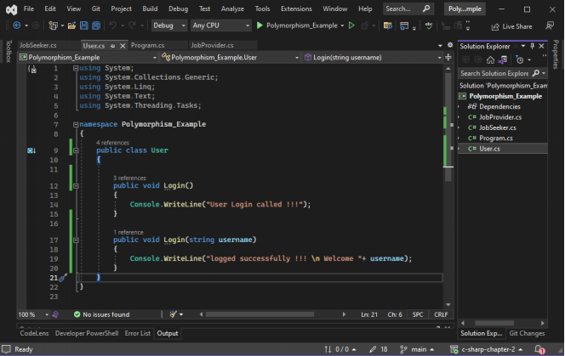
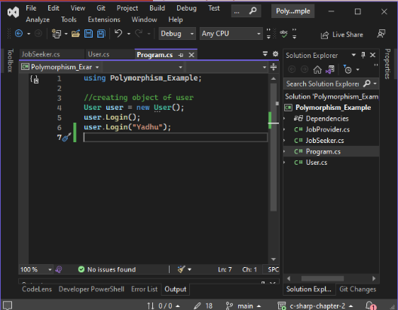

Slide 18
Method overriding
In a class hierarchy, when a method in a subclass has the same name and type signature as a method in its super class, then the method in the subclass is said to override the method in the super class.

Slide 19
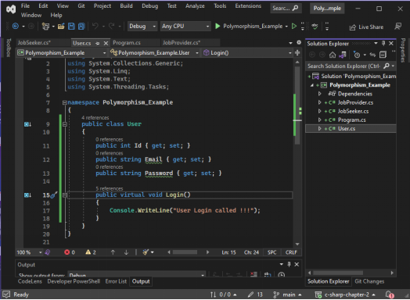
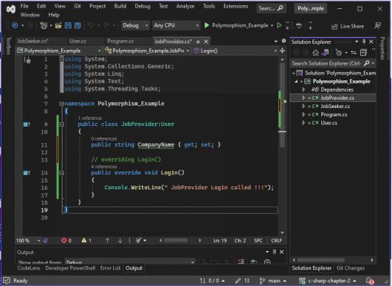

Slide 20
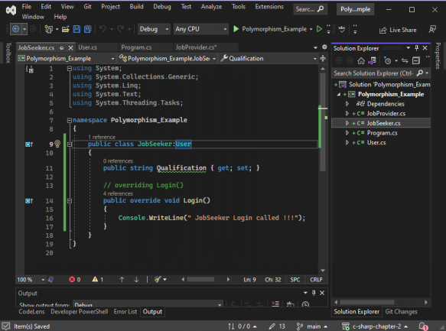
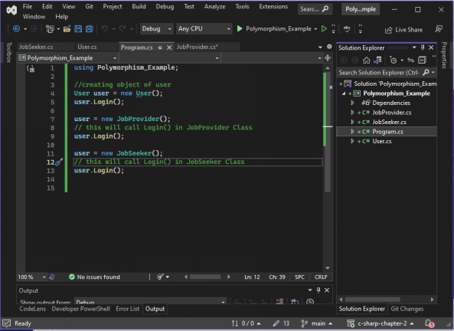

Slide 21
Abstract class
The abstract keyword is used for classes and methods.
Abstract classes are used to declare common characteristic of subclasses.
An abstract class cannot be instantiated , it can only be used as a super class for other classes thatextend the abstract class.
A parent class contains the common functionality of a collection of child classes but the parent class its self is too abstract to be used on its own
It can contain fields thagt contain its characters and methods.

Slide 22
interface
•Interface can be used to define a generic template and then one or more abstract classes to define partial implementations of the interface
•Interfaces just specify the method declaration. The method in the interface is implemented in the subclasses.
•Interface definition begins with the keyword interface. An interface like that of an abstract class cannot be instantiated.
•Using interfaces we can implement multiple Inheritance

Slide 23
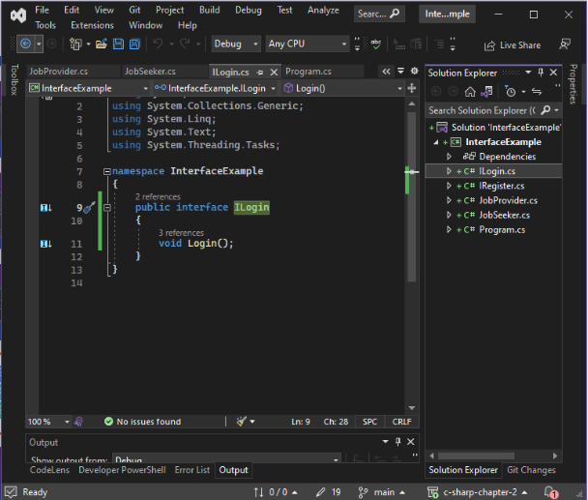
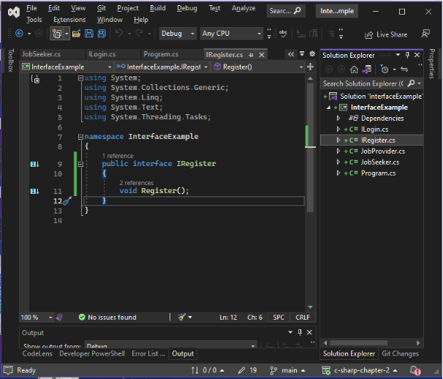

Slide 24
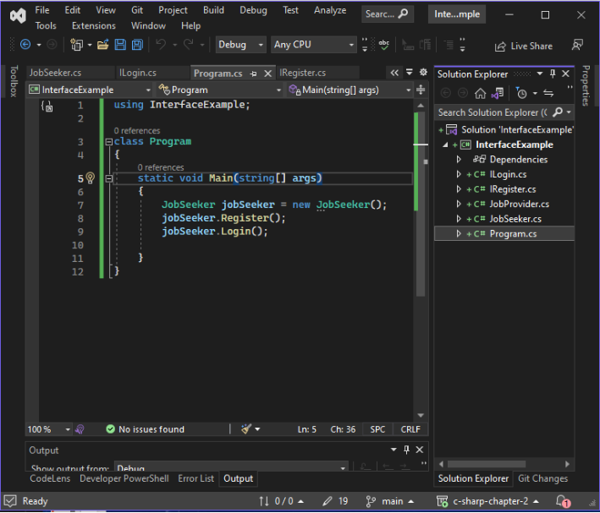
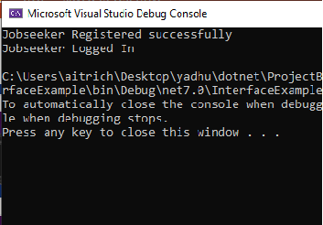

Slide 25
thank you

